Slide 1

THE EUROPEAN COUNCIL OF NATIONAL ASSOCIATIONS OF INDEPENDENT SCHOOLS
CONSEIL EUROPEEN D’ASSOCIATIONS NATIONALES D’ECOLES INDEPENDANTES
ECNAIS conference
Warsaw 17.-18. November 2011
ECNAIS
Theme:
The Independent Sector & diversity in education: Creating a Learning Society.
What independence of schools best serves the pupils and the society as a whole and why?
Independence from what?
Jón Torfi Jónasson
School of Education University of Iceland,
jtj@hi.is http://www3.hi.is/~jtj/

Slide 2
Take the theme first, and reverse the conceptual order
The Independent Sector & diversity in education: Creating a Learning Society.
Creating a Learning Society, learning society for the future.
What role does diversity play in the process?
What do we mean by diversity?
And then why would we be well served by independence and then independence from what?

Slide 3
The importance of independence
And then why would we be well served by independence and
then independence from what?

Slide 4
What is the question?
I suggest that there are two major questions that should be discussed in this connection, i.e.
What is education for (and who decides this)
  Do we in fact share a common educational vision to the extent that we often suggest?
  And where does the future enter the picture?
Who (what) controls its fate?

Slide 5
What is education for, and who decides?
Our systems of education rest on two perhaps three pillars??
  Belief in the power and importance of education
    education that needs to be dynamic, caring, efficient and economic
  A consensus that society takes care of basic education for a variety of reasons, but primarily
    a) in order to ensure its own interests which are based on equality, cohesion, democratic values, culture and key competencies, both new and traditional
    in order to ensure the interests of each individual (child)
  The basic principle of equality of opportunities and progress

Slide 6
What is education for, and who decides?
Now one may start to consider who decides?
Is it society that does this (or its agencies) or is it the pupils (i.e. the parents) that decide?
This may become a serious issue, depending on differing basic values of these agents and may explain some of the tension in the debate in various societies about free choice within the systems; I am of course referring to those who think that b) is the overwriting aim, and a) should not be.

Slide 7
What is education for, and who decides? The future added
But I think a very serious point is often being missed here, and that is the term “future”. Most people would say that this is of course implicit and doesn't need mentioning.
I suggest, that it may indeed be thus included, but in a very superficial sense and is in fact among the major omissions of the present thinking about education. Here it nevertheless becomes of considerable importance, what level of the educational system one is thinking; but in principle it applies to all levels.

Slide 8
Where are we now? On balance?
We have the school, it will be there for a while; but we must ensure that it is “in tune with the times and its role”

Slide 9
What is education for, and who decides?
Thus I want to complicate the theme somewhat by talking about a learning society for the future.

Slide 10
The future?
Discuss a learning society for the future, under two headings
Why must we look more aggressively to the future than we traditionally do? Here I will suggest the factors that we want to be dependent on (i.e. I suggest that your spaces should encompass).
Can we identify some forces that control or mould the development of our education? Here I will identify some of the factors that we want to be independent from; thus we want to create space to manoeuvre).
First I want to suggests that our perspective on education should change, probably more than many of us are prepared to admit.

Slide 11
The somewhat traditional aims of education tend to become only a subset of basic educational aims
The objectives of education
The objective of study based on the traditional subjects

Slide 12
I will now mention 10 important reasons why we must look to the future, more proactively than we tend to do?
  Each deserves a serious in depth discussion, but here we only have time just to mention each of them.
  Some of these arguments on their own might be deemed to be a sufficient cause for rethinking; but I think all of them taken together present a very powerful case for the reconceptualization of education.

Slide 13
So why should we, not be content with small steps forward?
  Many statutes (laws) on education, require the school system to prepare for the future, (even if we don’t exactly know how)
  In my own country, Iceland, we feel that social and ethical issues are (neglected) long term goals for education.
  The changes in the global economy calls for a discussion of the role of the education system, not only to respond to the employment market but to have a proactive influence. Education could play an active role rather than the thoroughly passive one it is accustomed to.

Slide 14
Why should we?
  IV. Global changes in the labour market, both cultural and technical within the jobs themselves, but also mobility issues.
    Jobs change fast, people move fast within a particular labour market; the situation in many sectors is already very different from what was the case only 10 years ago.
  V. The (over)use of the worlds resources and the general claim for a self sustainable local and global economy and culture. This presents an enormous challenge to the future generations; a host of problems need to be solved.
    Self sustainability, use of resources and energy production see e.g. UNESCO’s Teaching and Learning for a Sustainable Future.

Slide 15
Why should we?
  IV. The fast development of scientific and technological knowledge calls for a thorough revision of curriculum in a number of fields but probably even for totally new subjects for study.
    The doubling time in some fields is down to two years, but even if it is 5-10 years this is very fast. This should be taken into account.

Slide 16
Why should we?
  VII. Technological development allows for dramatic changes in a whole spectrum of tasks.
    In the computer field the doubling time is around 2-3 years. All kinds of tools for designing, writing, calculating etc. etc. will be used. Many tasks of today are already obsolete. Assume our kids will use these tools.

Slide 17
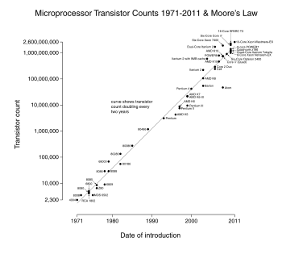

Slide 18
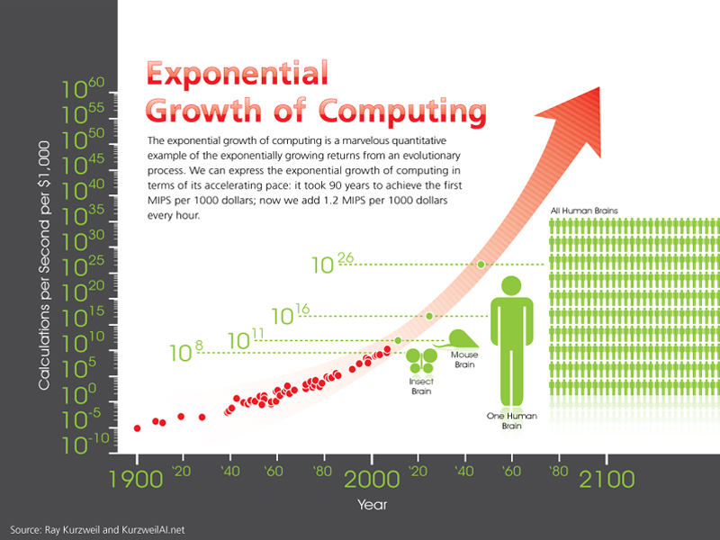
Staðan tekin

Slide 19
Why should we?
  VIII. The communication technology similarly calls for important changes.
    Whether it is the environment afforded by Web 2.0 or Web 3.0 (semantic web) , 4.0 (symbiotic web) we may anticipate important changes. The recent development of GSM, tablets etc. underlines that much of the technology the children use today will soon become obsolete; but some of ours schools still operate as if not even these instruments are there as normal tools of their lives.

Slide 20
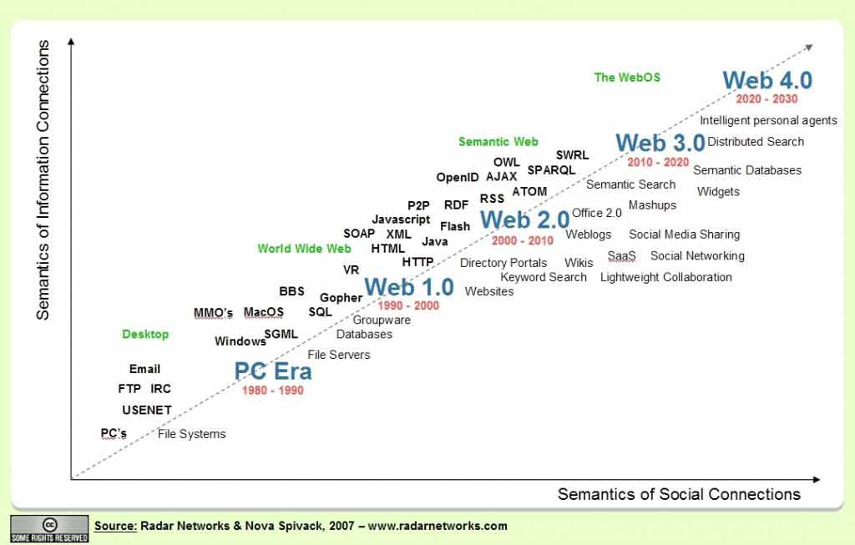
Staðan tekin

Slide 21
Why should we?
  IX. The demand for new skills for our new economy.
  This is a discussion that has got furthest but perhaps has made least headway. Now there are easily 20, 25 years this claim started to emerge (forgetting Dewey in the 1910s). The call was for new skills., but the matters has not had much success until with the new key factors introduced by the ministry in its national curriculum guide.
  Take creativity or entrepreneurship as an example

Slide 22
Skills that probably should play a central role in our curriculum; not a marginal role as some people think.
New skills, 21st century skills
http://ec.europa.eu/dgs/education_culture/publ/pdf/ll-learning/keycomp_en.pdf
http://www.p21.org/
http://www3.hi.is/~jtj/greinar/JTJ%20DISCUSSION%20PAPER%20May%2031-2010.pdf

Slide 23
Why should we?
  X. Substantial research on education, teaching and schooling affords a lot of suggestions for change to our educational practices.
    Thousands of research papers are published on every aspect of educational practice. But it is very unclear what impact it has on education; in fact the channels for the interaction between the two are not very wide. But a lost of suggestions for change exist.
    But research may sometimes only inspire research, let it not necessarily control all we do.

Slide 24
New world, new curricular wars
Complete renewal of the existing subjects
New subjects
The pedagogical, social and cultural role of the school must be emphasized all the way
The subjects of the 19th and the 20th centuries
New skills and key competencies
New tools, new cultures

Slide 25
Who (what) controls the development of education, who controls its fate?
Here I want to consider two classes of controllers, which are in fact interrelated,
The credential factor, or commodification of educational outcomes; the expansion of education; the system cannot stop expanding.
The inertial factors benevolently holding education back.

Slide 26
The credential factor, or commodification of educational outcomes
Here we must differentiate between different levels of education, what I say applies more clearly the higher one reaches in the educational hierarchy
(But note that parents start to think very early at what age it is sensible to let their child start school; in the highly credentialed systems)
The expansion of a tertiary system.
Note the robustness, the long-term regularity (invariance across many economic cultures), and an interpretation involving a consumer function (an exponential function, with saturation?).

Slide 27
Higher education: enrolment in Iceland 1911-1970

Slide 28
Higher education: enrolment in Iceland 1911-1970-2010

Slide 29
Higher education: enrolment in the US 1900-2008

Slide 30
Higher education: enrolment in the US 1900-2008

Slide 31
Higher education: enrolment in the US 1900-2008

Slide 32
Who (what) controls the development of education, who controls its fate?
Now I have discussed the credential or commodification control of educational expansion, and thus indirectly the control of a lot of education
and then I turn to the more complex but more intriguing plethora of interacting factors that hold back education, rightly or wrongly; note that I am certainly not talking about ill-meaning conspiratorial factors, but mostly implicit genuinely cultural or systemic factors that happen to be in control.
The inertial factors (benevolently) holding education back?

Slide 33
The “inertia” prediction of educational progress
  Educational systems evolve notoriously slowly; their history manifests this very clearly; this applies to their form, operation and content.
  The concerns, criticisms and visions of those concerned with education at the beginning of the 20th century were more or less the same as of those expressing themselves at the beginning of the 21st.
  (Chapter 9 in Reidar Myhres Grunnlinjer i pedagogikkens historie is a must in this context, a Norwegian text).

Slide 34
Why inertia? There are a number of important reasons.
  Traditions and traditional values keep education in the throes of old time (some see this as the role of education). The traditions are strong and so are the forces of inertia which stem from many sources.
  They relate to old or traditional values, old content and old ways of doing things. Of course some old values should be cherished, but which?

Slide 35
Why inertia? There are a number of important reasons. Reason no. 1
  A conservative discourse and ideas of many outside the educational system who naturally control the course of its development.
  I am here referring to the views of many parents and politicians; somewhat conservative impetus from industry that the education system serve the economy (yes, but how is that best done ?); teacher education, its content and organisation – related inter alia to the time since a lot of the teaching force graduated; conservative ideas proposed by the university as a European institution about the education of young people and generally outdated notions about content and how new techniques, new content and new cultures could permeate education. As an agent in this would also be some well established standardised tests, which volunteer to gracefully take the central stage, marginalising other contenders.

Slide 36
Why inertia? There are a number of important reasons. Reason no. 2
  The new ideas that are to replace the old, are sometimes woolly or cloudy, not well moulded and sometimes even vacuous. Some might even not be very good!
  This applies inter alia to some new ideas that were proposed during the 20th century, e.g. applied to discovery or project learning, ideas fostering creativity, arts or moral values; this also applies to some of the 21st century skills programmes which have been proposed repeatedly for the last 20-30 years. This will probably also apply to the new basic factors in the new EC eight key competencies.

Slide 37
Why inertia? There are a number of important reasons. Reason no. 3
  One reason why the push to introduce new ideas is somewhat undermined is that the rationale, the utility and ambition behind the introduction of the present ideas, some time ago, were all convincing and credible, even though it took a long time for them to win their place.
  The proponents of those ideas may still be operative and still think the ideas they adopted or fought for or introduced stand the test of time. This is partly a problem that may be traced to the older (my) generation but may also influence the judgement of those outstanding young people who did so well with the content and operations of the traditional environment.

Slide 38
Why inertia? There are a number of important reasons. Reason no. 4
  Nothing dramatic happens if we don't exchange new ideas for old ones. In fact nothing happens ― yet. This is the fourth reason why it is somewhat cumbersome to secure the place for new ideas replacing old well established and tested ones. (It is relatively safe not to instigate changes).
  The only ensuing problem is that young people are not given the opportunity to do a variety of interesting and valuable things, that new ideas, new technologies or new cultures might afford them; but of course they will survive nevertheless.

Slide 39
Why inertia? There are a number of important reasons. Reason no. 5
  It is especially important for those who want to argue for replacing new with old that one may seriously threaten a variety of vested interests and ideals of those who are already there. This may operate at several levels and perhaps present the most formidable obstacles of all I mention here.
  Here we may also introduce a variety of intra-institutional tensions that may stifle change.

Slide 40
Why inertia? There are a number of important reasons. Reason no. 6
  The sixth reason why new ideas don't emerge is that very few people who are engaged in education have the overview or wide perspective over all the different but pressing reasons for change. Very few have the responsibility or opportunity to follow the many quite substantial changes in the social and ethical and technological and cultural environment and speculate about the possible educational implications. The perspective we, in the educational arena, have is often very narrow, far too narrow.

Slide 41
Why inertia? There are a number of important reasons. Reason no. 7
  The seventh reason relates to the relationship of educational practice to research. This is an intriguing situation. On the one hand, enormous amount of potential inspiration from research does not find its way into education. There is no venue. That is a major problem. On the other hand if one gets too preoccupied with research into particular problems one may get stuck with attempting to solve those without moving on. Thus the relationship with research is a major problem
  Thus I have presented a number of reasons why a prediction involving rather modest but gradual development of education is probably reasonable.

Slide 42
Creating a Learning Society, - learning society for the future.
We have now been discussing, why a new educational perspective must be adopted, and some of the reasons why this may amount to a fairly steep uphill walk.

Slide 43
Diversity! What role does diversity play in the process?
Diversity, why do we talk about it, what does it mean and what are the pros and what are the cons?
Many of us think that encouraging diversity may be the only way out of an impasse; to allow thousand blooms to blossom and thus create the pre-conditions – the climate – for a dynamic development.

Slide 44
A host of studies
Various studies on systems of management, finacing, school choice, private public institutions
Benveniste, Carnoy, Rothstein (2003). All else equal. Are public and private schools different?
  The answer is very clear
  yes
  and no

Slide 45
Diversity, a positive or a negative term?
The positive connotation implies variety, multiplicity, heterogeneity, the antonym to every thing being the same, being uniform;
It celebrates the wide spectrum of life, of culture, of human kind; it implies space(s) to manoeuvre.
Many of us attach a substantial positive value to it.
A potentially negative meaning, i.e.
diversity or difference, ― in social class, income, background, ability
= social or individual inequality; this is a meaning normally not attached to the term, but is noted here to remind ourselves that diversity may not uniformly be given a positive meaning
Thus the general notion is that diversity is positive while inequality is negative.

Slide 46
Diversity in education, a number of dimensions, e.g.
Whole school approaches, comparison between schools
Clientele (e.g. elitist education, special education, ...)
Educational vision (reflected in practice; Montessori, Waldorf, Reggio, Hjallastefna ...
Social vision (e.g. denominational schools, ...
Curricular emphasis (e.g. on maths, sport, music, creativity, ...
Within schools diversity
Different approaches to different pupils, but essentially the same aims
Different aims for different pupils, perhaps also different approaches
Organizational diversity
Different funding or management or administrative categories (Charter schools, private schools, for profit education, public education, ....

Slide 47
Arguments for diversity
We live in a very complex society, the tasks and possibilities are boundless; it seems unreasonable that all attend to some of the important tasks and none to others (referring to standardised curriculum).
There is an enormous variation in our student populations, and indeed in our teacher populations; it is somewhat unreasonable to assume that one framework fits all, even though it is quite loose.
There are indeed many ways to conduct education well and there is no reason to believe that there is the one best avenue (even though some think they have found it).
Competition between ideas sometimes leads to progress.
Diversity breads dynamism. Different groups explore different avenues which in turn opens up discourses and hopefully some development.

Slide 48
General arguments against diversity
A lot of effort has been put into selecting what is the absolute basics every citizen has to have at her or his command; it is not acceptable that only some have it but not others.
The educational system is based on a progress through it and thus the next stage must be able to assume some basis from the previous stages.
Most differentiation implies some categorization (if inadvertently), such as status differentiation and social tension.
Differentiation threatens to weaken the position of those whose position is already weak (schools, pupils, families).
The inequality issue

Slide 49
The problem with inequality
The consensus seems to growing that social equity plays a causal role for a variety of important social and personal factors such as economic growth, educational outcome, low crime rate, better physical and mental health, etc.
Thus it is important to ensure that the strive for diversity does not lead to inequality.
But at the same time it is important to note that this problem does certainly not need to stifle the search for diversity, but we need to be aware of the problem.

Slide 50
Equality
Coulombe, S., J-F. Tremblay and S. Marchand (2004), Literacy Scores, Human Capital and Growth across Fourteen OECD Countries, Statistics Canada/Human Resources and Skills Development Canada, Ottawa.
Social equity vis-à-vis the work force seems to be advantageous.
“This finding is in line with the idea that the principal impact of education on growth is to raise the productivity of the whole workforce, rather than to increase the number of individuals able to bring about radical innovations.” Education at a Glance 2005, p. 149.

Slide 51
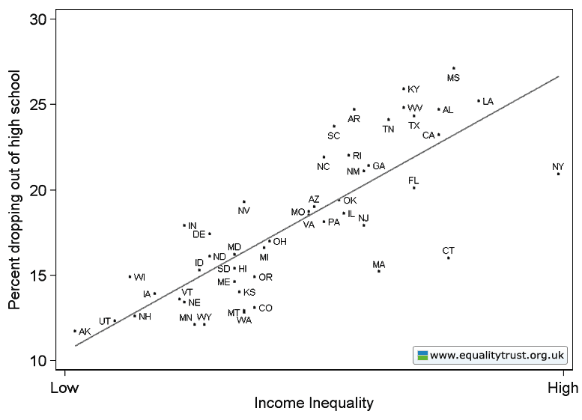
The problem with inequality: the US (the 20:20 scale)

Slide 52
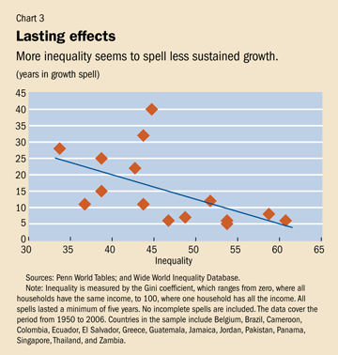
International Monetary Fund
Finance & Development, September 2011, Vol. 48, No. 3
Andrew G. Berg and Jonathan D. Ostry
“Do societies inevitably face an invidious choice between efficient production and equitable wealth and income distribution? Are social justice and social product at war with one another?
In a word, no.”
“That experience brought home the fact that sustainable economic reform is possible only when its benefits are widely shared. “

Slide 53
Drawing to a close
The Independent Sector & diversity in education: Creating a Learning Society.
Creating a Learning Society, learning society for the future.
We have noted some important reasons why we have to move forward; reasons that I think are compelling.
We have noted a variety of controlling or constraining factors that will hold us back, often for a good reason.
We have touched on the role diversity plays in the process of developing education and thus by implication why our education systems would be well served by, at least some considerable degree of independence.

Slide 54
Conclusion summary
The Independent Sector & diversity in education: Creating a Learning Society.
Creating a Learning Society, learning society for the future.
We have noted some important reasons why we have to move forward; reasons that I think are compelling.
We have noted a variety of controlling or constraining factors that will hold us back, often for a good reason.
We have touched on the role diversity plays in the process of developing education and thus by implication why our education systems would be well served by, at least some considerable degree of independence.
ECNAIS conference Warsaw nov 2011 JTJ

Slide 55
Conclusion summary
What independence of schools best serves the pupils and the society as a whole and why?
Independence from what?
Independence from the constraints, the forces that want always to hold on, want not to move.
Note that I have been emphasising content, curriculum, educational culture rather than organization factors.
I am, perhaps somewhat obliquely, calling for a clear educational vision, for a move into the future and for an understanding of the factors that hold us unduly back.
ECNAIS conference Warsaw nov 2011 JTJ

Slide 56
ECNAIS conference Warsaw nov 2011 JTJ
Thank you very much
Kærar þakkir

